Slide 1

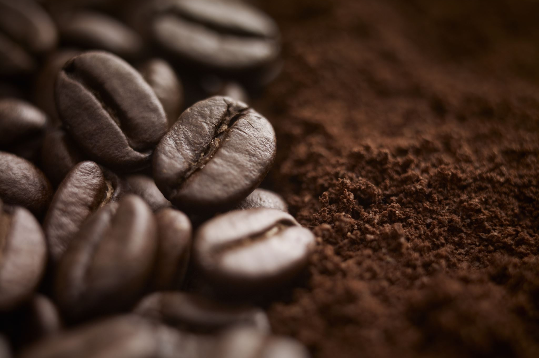

COFFEE SHOP SALES ANALYSIS

Slide 2

RECOMMENDED ANALYSIS
How do sales vary by day of the week and hour of the day?
Are there any peak times for sales activity?
What is the total sales revenue for each month?
How do sales vary across different store locations?
What is the average price/order per person
Which products are the bestselling in terms of quantity and revenue?
How do sales vary by product category and type?

Slide 3

Insights
Mon& Fri are days with highest sales. On an average 7:30 AM to 10 AM are usually the peak hours.
April to June has the most sales.
Hell’s Kitchen has the most orders as well as sales.
By sales, Barista Espresso tops the list. And by order count, Brewed Chai tea tops the list.
Regular sized orders are the most preferred.

